Slide 1

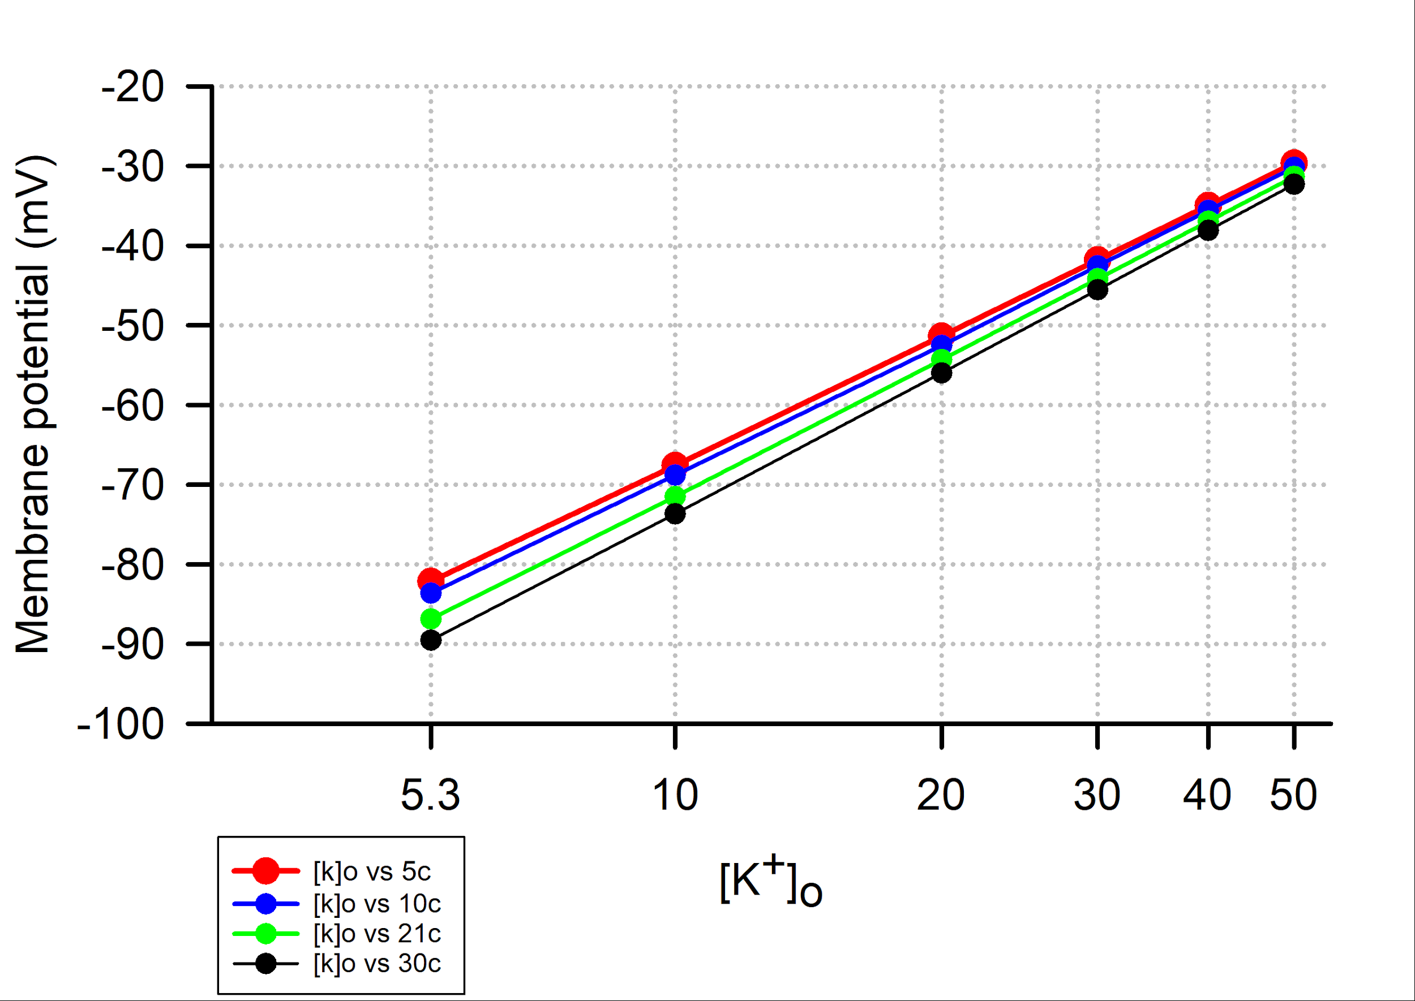
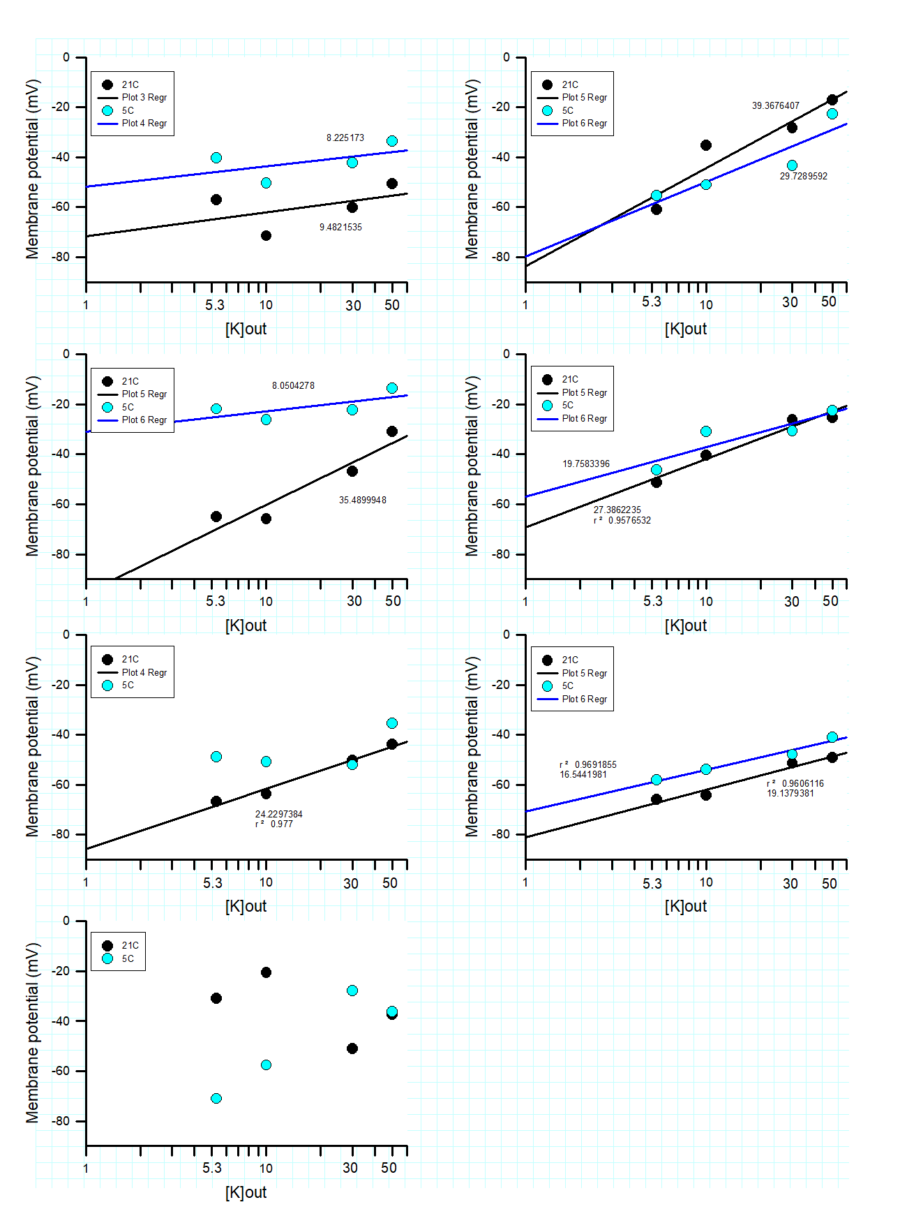
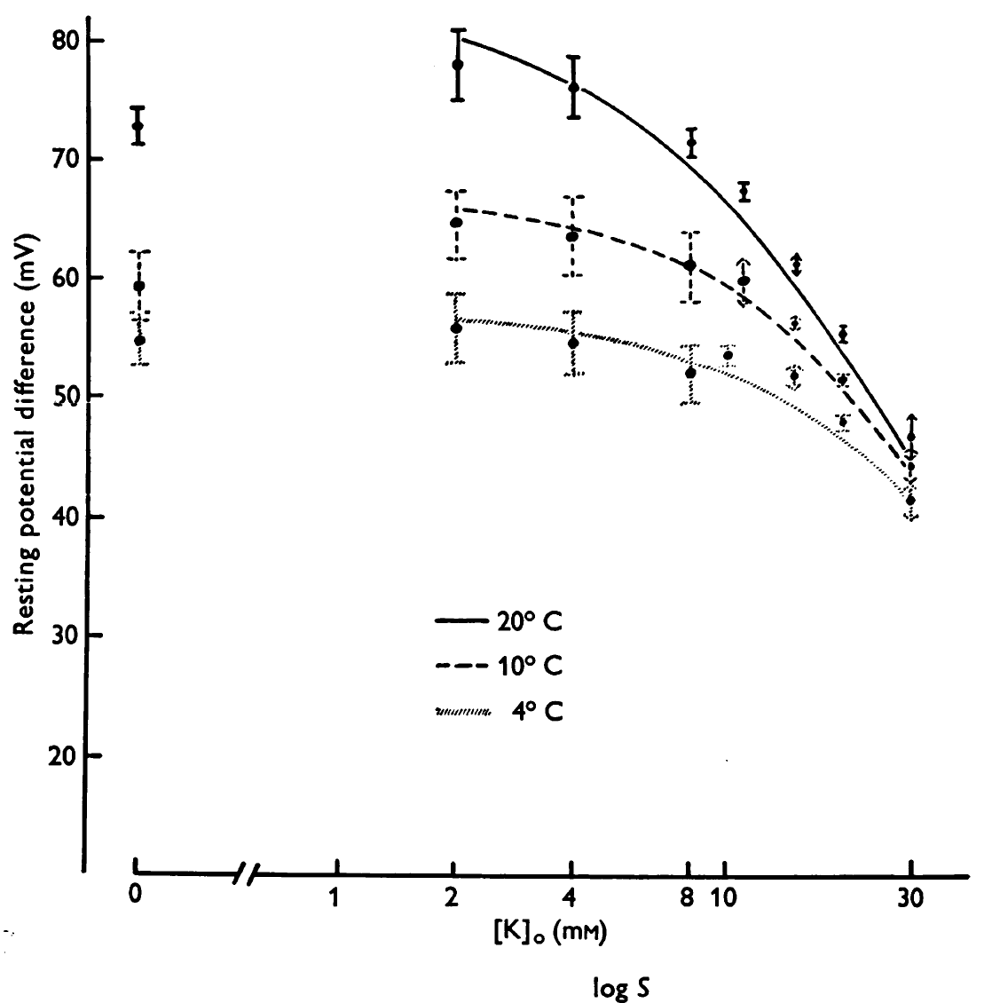
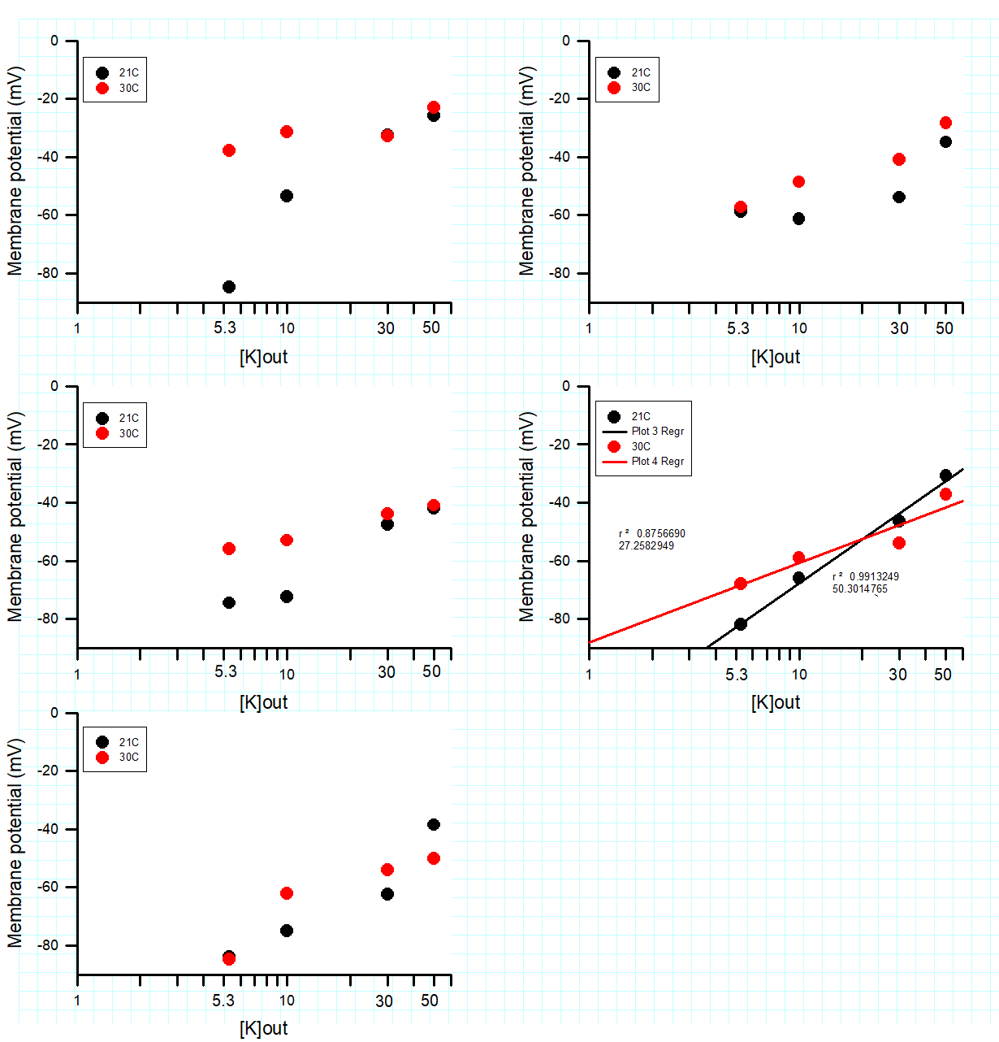

The Temperature Dependence on the Passive Effects of Potassium Ions on the Membrane Potential of Skeletal Muscle
Janki Naidugari¹, Dara Buendia Castillo^{1,2}, Mohammad Abou El-Ezz¹, Cameron Brown¹, Tom Calderaro¹, Cameron Evans¹, Trey Grant¹, Rachel Hazelett¹, Cassity High¹, Tessa Ilagan¹, Jack Klier¹, Nicole Marguerite¹, Felicia Marino¹, Shelby McCubbin¹, Nicholas Meredith¹, Blair Nethery¹, William Russell¹, Noah Sommers¹, Esther E. Dupont-Versteegden^{2,3}, Rebecca Krall⁴, Katherine Sharp⁴, Jeffrey Chalfant⁴, Mia Brown⁴, and Robin L. Cooper^{1,2}
¹Department of Biology, University of Kentucky, Lexington KY 40506-0225 USA ; ²Center for Muscle Biology, University of Kentucky, Lexington KY 40536-0200 USA
³Charles T. Wethington Jr. Building, University of Kentucky, Lexington KY 40536-0200 USA; ⁴Department of STEM Education, University of Kentucky, Lexington, KY 40406-0001, USA
Abstract
In modifying a typical physiological laboratory protocol in measures of the resting membrane potential in relation to the concentration of extracellular potassium ions [K⁺]_{o,} the additional effects of temperature were addressed. The effects of temperature on the membrane potential are not commonly addressed in experimental physiology and neurophysiology student laboratory exercises. In terms of presenting an authentic application of the experimental design various topics were discussed with the class. This workshop presents how this was addressed for a physiology or a neurophysiology laboratory course. Crayfish are used as models in empirically addressing the effects of temperature and [K⁺]_{o} change as one topic and a second focus was on clinical therapies related to the use of varied temperatures in mammals. A third topic focused on a unified issue with all organisms in temperature changes with cellular metabolism. Experimentally the skeletal muscle of a crayfish serves as model to obtain data due to the robust nature of the preparation for student laboratories. Graphing membrane potential in relation to both [K⁺]_{o} and temperature along with theoretical curves for the Nernst and Goldman-Hodgkin-Katz (G-H-K) equations provides important distinctions and the relationship of temperature in these equations. Freely available online software is used in addressing the theoretical values one would expect for changing the variables in the G-H-K equation. Discussion of other factors impacted by temperature for biological membranes will also covered. A pre- and post-survey over general content and views on the activities will be discussed from running this activity with a group of 16 undergraduate students. The modules are designed to be used in a hybrid or remote format with data provided online with sample data sets as well as movies of the procedures. The exercises can also be conducted by in class participants.
Materials and Methods
Theoretical calculations empirical measures of membrane potential
To begin this, exercise the Nernst equation and Goldman-Hodgkins-Katz equation (GHK) need to be addressed.
Equations that are commonly used to determine the equilibrium potential of an ion and resting membrane potential are the Nernst equation and the Goldman-Hodgkin-Katz (G-H-K) equation, respectively. An important distinction between the two equations is that the Nernst equation is used only for one specific ion to determine the equilibrium potential for that ion, whereas the G-H-K equation is used to determine the resting potential by considering the permeability of multiple ions and their gradients across a cell membrane (Nernst, 1888, 1889; Goldman, 1943; Hodgkin and Huxley, 1952; Hodgkin et al., 1952; Hodgkin and Katz,1949; see Hille, 1992). Nernst equation :
$$V=\frac{RT}{zF} ∙ln\frac{⁡{[X]}_{out}}{{[X]}_{in}}$$
Considering that a membrane can be permeable to more than one ion at rest, as well as at various depolarized states, one uses the G-H-K equation to take into account the permeability (P in the equation) for various ions. The G-H-K equation will reduce to the Nernst equation if a membrane is permeable to only one ion.
Here is a generalized G-H-K equation for Na⁺, K⁺, and Cl⁻ ions:
$${Em}_{K, Na, Cl}=\frac{RT}{F}lnln \frac{P_{{Na}^{+}}{\left[{Na}^{+}\right]}_{out}+P_{K^{+}}{\left[K^{+}\right]}_{out}+PCl[Cl]in}{P_{{Na}^{+}}{\left[{Na}^{+}\right]}_{in}+P_{K^{+}}{\left[K^{+}\right]}_{in}+PCl[Cl]out}$$
Computational data
Student obtained graphical analysis of the computational obtained data for four different temperatures and varying [K⁺]_{o}. This data is also presented in tabular form in supplemental information for instructors to use as they wish for their classes.
DISCUSSION AND THOUGHT PROBLEMS
Students are focused on being able to determine how the external concentrations of K⁺ affects the membrane potential and that this effect also varies with temperature.
The students should not be discouraged if their values are not close to the predicted values. This can be due to several different factors in relation to temperature.
As mentioned in the Fischbarg (1972) study of muscles in barnacles, the author states the differences from theoretical values are likey due to alteration in permeability of the potassium leak channels. If the students were so inclined, they could try different values of permeability in the simulation at the higher temperatures to try to fit the theoretical values to the experimental measures.
By having the students run through the simulation prior to the experimentation the understanding in that temperature is critical in altering the membrane potential.
The concerns with using the simulation is having values to use for intracellular ion concentrations. There are few student friendly experimental tissues with reported values in the literature. This did bring up conversations how did researchers come up with the values to use. Even in the well-studied crayfish skeletal muscles differing values are reported for internal K⁺ and Na⁺ concentrations. This also brought up discussion point on different cell types if the ionic concentrations are similar. This then lead back to why some cells have varied resting membrane potentials and different equilibrium potentials for the ions compared to other cells.
Detailed information and protocol is presented on this web page:
http://web.as.uky.edu/Biology/faculty/cooper/ABLE-2021/ABLE-2021-MembranePotenial-tempAndK/Home-Temperature%20dependence%20on%20the%20passive%20effects%20of%20K%2B%20on%20membrane%20potential-ABLE%202021.htm
Experimental results
Half the of the class examined the membrane potential at room temperature 21ºC with altering the [K⁺]_{out} and again at 5ºC in one lab setting and other half of the class used 21ºC with altering the [K⁺]_{out} and again at 30ºC. The individual graphs of each student's results are shown below. Linear regression lines are shown for some graphs of the data which indicated a linear relationship.
Introduction
This exercise is focused on a novel approach with combining the standard membrane potential and raised [K⁺]_{o} paradigms to include the effect of temperature on the membrane potential. In this exercise, theoretical graphs of membrane potential and the relationship with variation of [K⁺]_{o} are to be made with an on line program. The effect of temperature in relation to the curves is also to be calculated and discussed. Experimentally, students will measure membrane potentials in a muscle of crayfish and vary [K⁺]_{o} at various temperatures. The experimental data will be graphed and compared with the computationally obtained data for group discussion. The experimentally obtained values are to be plotted in relation to the theoretical Nernst equation. The deviation in the curves would likely bring up the topic of the Goldman-Hodgkin-Katz (G-H-K) equation and why the G-H-K equation is a better fit for the experimentally obtained data (Atwood and Parnas, 1968; Baierlein et al., 2011; Johnson et al., 2014; Wyttenbach et al., 1999).
Relating this integrative topic to real world applications, three general themes are presented for one to contemplate. The first theme is to address the topic with heterothermic animals, such as crustaceans and insects, which can be exposed to wide variations in temperature abruptly as compared to seasonal changes or longer-term climate change. In addition, addressing a true hibernating mammal, such as a squirrel, and the effects on cells within this animal are also discussed. The second theme is to address the potential implications with clinical therapies, such as a cold or warm pack on injured tissue and cold induced coma for reducing neural and heart function. In addition, a third theme in the commonalty regarding heterotherms and homeotherms with cellular metabolism which results in thermal changes.
Use the on-line simulator from
Online https://www.physiologyweb.com/calculators/ghk_equation_calculator.html
(note: values of temperature are in K which is 273.15 + the # in centigrade)
Graph the results obtained from the online simulation for membrane potential based on the above values and for 5.3 mM, 10 mM, 20 mM, 30 mM, 40 mM, and 50 mM for [K]_{o} and using 5ºC, 10ºC, 21ºC, and 30ºC . Plot in a similar manner to those obtained for the barnacle muscle (Figure 1; copied from Fischbarg, 1972; https://doi.org/10.1113/jphysiol.1972.sp009886).
The effect of extracellular K⁺ and temperature on the membrane potential in barnacle muscle. Copied with permission from Fischbarg (1972). Note the Y-axis is a change in the membrane potential becoming more negative with reduced extracellular K⁺ and higher temperature. https://doi.org/10.1113/jphysiol.1972.sp009886

